Slide 1
Model-Based Testing
G
J
F
K
A
B
D
I
C
H
E
Harry Robinson
Google
harryr@google.com

Slide 2
Goals for Today
Learn techniques for test generation
Acquire a mindset
Foster discontent

Slide 3


What are the Problems of Software Testing?
Time is limited
Applications are complex
Requirements are fluid

Slide 4
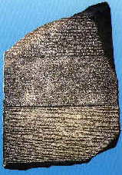
Scripted Test Automation
WSetWndPosSiz(CurrentWindow, 7, 3, 292, 348)
WMenuSelect("&Settings\&Analog")
Sleep(2.193)
WMenuSelect("&Settings\&Digital")
Sleep(2.343)
Play "{DblClick 130, 188, Left}"
WResWnd(CurrentWindow)
Sleep(2.13)
Play "{Click 28, 36, Left}"
Play "{Click 142, 38, Left}"
Play "{DblClick 287, 16, Left}"
Unchanging
Chiseled in stone
Usually undecipherable

Slide 5
Traditional Automated Testing
Imagine that this projector is the software you are testing.

Slide 6
Traditional Automated Testing
Typically, testers automate by creating static scripts.

Slide 7
Traditional Automated Testing
Given enough time, these scripts will cover the behavior.

Slide 8
Traditional Automated Testing
But what happens when the software’s behavior changes?

Slide 9
Model-Based Testing
Now, imagine that the top projector is your model.

Slide 10
Model-Based Testing
The model generates tests to cover the behavior.

Slide 11
Model-Based Testing
… and when the behavior changes…

Slide 12
Model-Based Testing
… so do the tests.

Slide 13
So What’s a Model?
A model is a description of a system’s behavior.
Models are simpler than the systems they describe.
Models help us understand and predict the system’s behavior.

Slide 14

Approaches to Automated Testing
Static Tests
Monkey Tests
Model-Based Tests

Slide 15
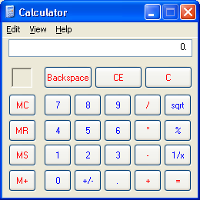
Calculator: A Fairly Typical GUI
Familiar enough
Simple enough
Complex enough
Hard to test thoroughly

Slide 16
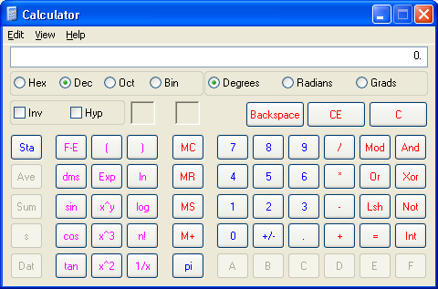
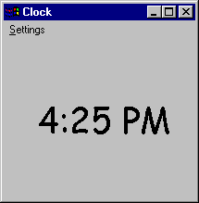
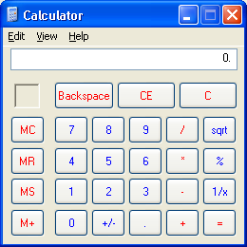
Calculator GUI Behavior
Not Running
Not Running
Scientific
Start
Stop
Start
Stop
Standard
Scientific
Standard

Slide 17
Monkey Testing vs. The Calculator
Start Standard Standard Standard Scientific Scientific Scientific Scientific …
Not Running
Not Running
Scientific
Start
Stop
Start
Stop
Standard
Scientific
Standard

Slide 18
Static Tests vs. The Calculator
Test Case 1: Start Stop
Not Running
Not Running
Scientific
Start
Stop
Start
Stop
Standard
Scientific
Standard

Slide 19
Static Tests vs. The Calculator
Test Case 2: Start Scientific Standard Stop
Not Running
Not Running
Scientific
Start
Stop
Start
Stop
Standard
Scientific
Standard

Slide 20
Static Tests vs. The Calculator
Test Case 3: Start Scientific Stop Start Standard Stop
Not Running
Not Running
Scientific
Start
Stop
Start
Stop
Standard
Scientific
Standard

Slide 21
Static Tests vs. The Calculator
Test Case 4: Start Standard Scientific Scientific Standard Stop
Not Running
Not Running
Scientific
Start
Stop
Start
Stop
Standard
Scientific
Standard

Slide 22
So, here’s your test case library
Test Case 1: Start Stop
Test Case 2: Start Scientific Standard Stop
Test Case 3: Start Scientific Stop Start Standard Stop
Test Case 4: Start Standard Scientific Scientific Standard Stop
Not Running
Not Running
Scientific
Start
Stop
Start
Stop
Standard
Scientific
Standard

Slide 23
But, really, what are you left with?
Hard-coded test cases – lots of ‘em
Tests that do only what you told them to
Tests that wear out due to pesticide paradox

Slide 24

Robinson’s Twinkie Law of Scripted Automation
The useful life of a traditional automated test
is significantly less
than the shelf life of a Twinkie.

Slide 25
MBT vs. The Calculator
Scientific
Setup: Calculator is running in Standard mode
Action: Select Scientific mode
Outcome: Did Calculator go correctly to Scientific mode?

Slide 26
We All Use Models Already
Scientific
hmm …
if I am in Standard mode
and I select Scientific mode
I should end up in Scientific mode

Slide 27
Steps for Creating a Model
Walk through some scenarios
  What model do you have in your head?
  How do you know what you expect to see?
Figure out your scope:
  What are you testing?
  What are you ignoring?
Figure out a useful representation

Slide 28
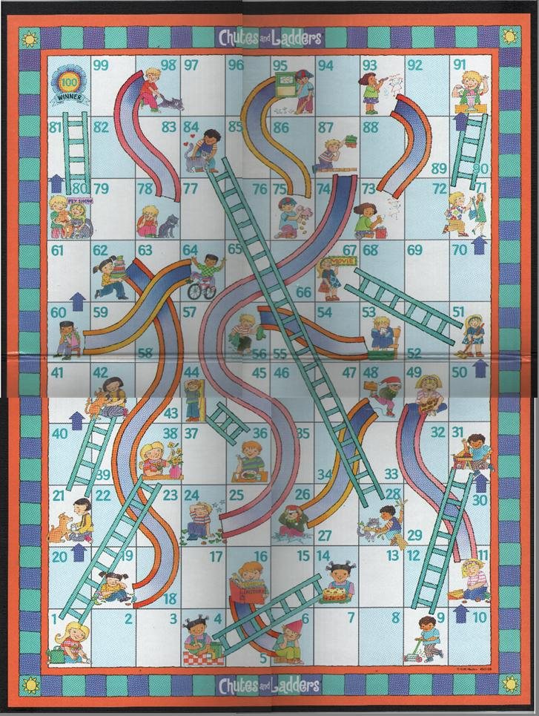
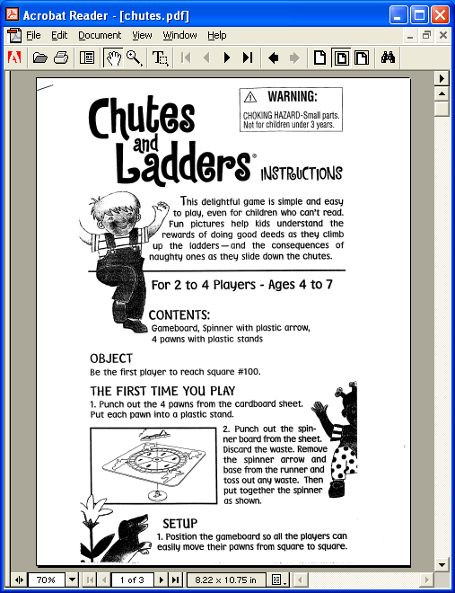
Exercise:
Modeling from a Spec

Slide 29
Questions for the CNL Spec
Easy:
Who can play the game?
Where do players start?
What happens when you land on an occupied square?
Harder:
Are there squares you should never finish your turn on?
What happens when you spin a 6 from square 97?
Extra credit:
What is the fewest number of spins needed to finish the game?
How many such sequences are there?

Slide 30
If you were writing traditional test cases for Chutes N Ladders, what would those test cases look like?

Slide 31
Questions when Modeling Chutes N Ladders
What do we want to track in the CNL model?
What do we want to ignore in the CNL model
What features do we want to test?
  The game?
  The spinner?
  The artwork?
  The moral lessons?
What kind of test do we want to run?
  BVT?
  Random?
  Exhaustive?

Slide 32
Questions we are not asking …
“… I am not as pleased with the relationship of chore completion earning material activities (such as sweeping earning a trip to the movies) or things (carrying mom’s purse equaling an ice-cream sundae). “
- from a review of Chutes and Ladders

Slide 33
A Graph is a Type of Model
A Few Quick Graph Theory Terms
arc
start node
end node

Slide 34
State Variables in the Calculator GUI
The System is either
  NOT_RUNNING or
  RUNNING
The Mode is either
  STANDARD or
  SCIENTIFIC
NOT_RUNNING
STANDARD
NOT_RUNNING
SCIENTIFIC
Start
Stop
Start
Stop
RUNNING
STANDARD
RUNNING
SCIENTIFIC
Standard
Scientific
Standard
Scientific

Slide 35
All Actions Aren’t Always Available
Calculator = NOT RUNNING
AND
Action = Stop
Rule: You can’t execute the Stop action
if the Calculator is not running

Slide 36
Finding the Rules
Stop
When the System is NOT_RUNNING, the user cannot execute the Stop action.
When the System is RUNNING, the user can execute the Stop action.
After the Stop action executes, the System is NOT_RUNNING.

Slide 37
The Generated Finite State Table
Beginning State
Action
Ending State
NOT_RUNNING.STANDARD
Start
RUNNING.STANDARD
NOT_RUNNING.SCIENTIFIC
Start
RUNNING.SCIENTIFIC
RUNNING.STANDARD
Stop
NOT_RUNNING.STANDARD
RUNNING.SCIENTIFIC
Stop
NOT_RUNNING.SCIENTIFIC
RUNNING.STANDARD
Standard
RUNNING.STANDARD
RUNNING.STANDARD
Scientific
RUNNING.SCIENTIFIC
RUNNING.SCIENTIFIC
Standard
RUNNING.STANDARD
RUNNING.SCIENTIFIC
Scientific
RUNNING.SCIENTIFIC

Slide 38
A Random Walk
NOT_RUNNING
STANDARD
NOT_RUNNING
SCIENTIFIC
Start
Standard
Standard
Scientific
Scientific
Scientific
Scientific
…
Start
Stop
Start
Stop
RUNNING
STANDARD
RUNNING
SCIENTIFIC
Standard
Scientific
Standard
Scientific
re-inventing the monkey

Slide 39
All States (salesman)
NOT_RUNNING
STANDARD
NOT_RUNNING
SCIENTIFIC
Start
Scientific
Stop
Start
Standard
Stop
Start
Stop
Start
Stop
RUNNING
STANDARD
RUNNING
SCIENTIFIC
Standard
Scientific
Standard
Scientific
reach every state in the model

Slide 40
All Transitions (postman)
NOT_RUNNING
STANDARD
NOT_RUNNING
SCIENTIFIC
Start
Standard
Scientific
Scientific
Stop
Start
Standard
Stop
Start
Stop
Start
Stop
RUNNING
STANDARD
RUNNING
SCIENTIFIC
Standard
Scientific
Standard
Scientific
execute every action

Slide 41
All State-Changing Transitions
NOT_RUNNING
STANDARD
NOT_RUNNING
SCIENTIFIC
Start
Scientific
Stop
Start
Standard
Stop
Start
Stop
Start
Stop
RUNNING
STANDARD
RUNNING
SCIENTIFIC
Standard
Scientific
Standard
Scientific
execute every state-changing action

Slide 42
Shortest Paths First
NOT_RUNNING
STANDARD
NOT_RUNNING
SCIENTIFIC
Length = 2
  Start Stop
Length = 3
  Start Standard Stop
Length = 4
  Start Standard Standard Stop
  Start Scientific Standard Stop
and so on …
Start
Stop
Start
Stop
RUNNING
STANDARD
RUNNING
SCIENTIFIC
Standard
Scientific
Standard
Scientific
execute every path (eventually!)

Slide 43
Most Likely Paths First
NOT_RUNNING
STANDARD
NOT_RUNNING
SCIENTIFIC
Probability = 0.19
  Start Stop
Probability = 0.1216
  Start Scientific Standard Stop
and so on …
P=.19
P=.19
Start
Stop
Start
Stop
RUNNING
STANDARD
P=.80
RUNNING
SCIENTIFIC
Standard
Scientific
P=.80
Standard
Scientific
execute favored paths in order
P=.01
P=.01

Slide 44
Executing the Test Actions
open "test_sequence.txt" for input as #infile ‘get the list of test actions
while not (EOF(infile))
line input #infile, action ‘read in a test action
select case action
case “Start“ ‘ Start the calculator
run("C:\WINNT\System32\calc.exe”) ‘ VT call to start calculator
case “Standard“ ‘ choose Standard mode
WMenuSelect(“View\Standard") ‘ VT call to select Standard
case “Scientific“ ‘ choose Scientific mode
WMenuSelect(“View\Scientific") ‘ VT call to select Scientific
case “Stop“ ‘ Stop the calculator
WSysMenu (0) ‘ VT call to bring up system menu
WMenuSelect ("Close") ‘ VT call to select Close
end select
wend

Slide 45
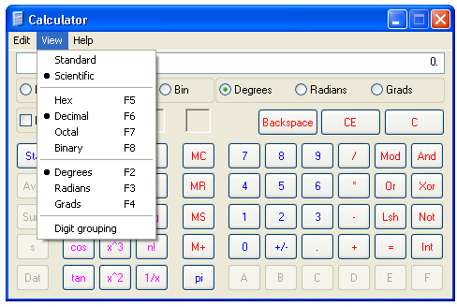
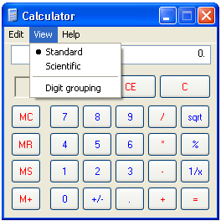
Use Rules as Heuristic Test Oracles
if ( (setting_mode = STANDARD) _ ‘if we are in Standard mode
AND NOT WMenuChecked(“View\Standard") ) then ‘but Standard is not check-marked
print "Error: Calculator should be Standard mode“ ‘alert the tester
stop
endif

Slide 46
Executing tests quickly
c
d
????
e
a
b
i
f
g
h
a b c b d b e b f b g b h b i
A single test machine approach takes 15 time intervals.

Slide 47
But distributing the work ...
a
b
c
b
i
a
b
d
b
i
a
b
e
b
i
a
b
f
b
i
a
b
g
b
i
a
b
h
b
i
… gets the job done in 1/3 the time!

Slide 48
An Anti-Random Walk
NOT_RUNNING
STANDARD
NOT_RUNNING
SCIENTIFIC
Start
Scientific
Standard
Scientific
Stop
1
4
Start
Stop
Start
Stop
RUNNING
STANDARD
RUNNING
SCIENTIFIC
3
Standard
2
Scientific
Standard
Scientific
visit states most different from where you’ve been

Slide 49

Levy Flights
Probability of step’s length is in inverse proportion
to the square of that length.

Slide 50
Models + Traversals = Testing
State models are good at representing systems
You can use models to generate tests
Different algorithms can provide tests to suit your needs:
  Random walk
  All states
  All transitions
  State-changing transitions
  Shortest paths first
  Most likely paths first
  Anti-random walks
  Levy flights

Slide 51
Leveraging Models:
Beeline & Gawain

Slide 52
The Motivation
“The fewer steps that it takes to reproduce a bug,
the fewer places the programmer has to look (usually).
If you make it easier to find the cause and test the change,
you reduce the effort required to fix the problem.
Easy bugs gets fixed even if they are minor.“
- from Testing Computer Software

Slide 53
The repro path reduction problem
1
2
3

Slide 54
Random walk finds a bug
1
2
3
… but the repro path is inconveniently long

Slide 55
The Beeline Approach
Choose any 2 nodes in the path
Find the shortest path between them
Execute the spliced ‘shortcut’ path
Evaluate the results and repeat

Slide 56
Leveraging Models:
Beeline
Choose any 2 nodes in the repro sequence
Find the shortest path between them
Try the shortcut path
If the shortcut works, keep it
Repeat

Slide 57
1. Choose any 2 nodes in the path
1
2
3

Slide 58
2. Find shortest path between them
1
2
3

Slide 59
3. Execute the spliced shortcut path
1
2
3
The bug repro’ed - this is the new shortest path

Slide 60
Continue trimming …
1
A
2
B
3

Slide 61
… until you stop.
1
2
3

Slide 62
Why Use a Model for Reducing?
The model can detect (and therefore reduce) both crashing AND non-crashing bugs
Finding a shortcut is simple in a model, so the reduction is more efficient
Finding bugs is good, but getting them fixed is better

Slide 63
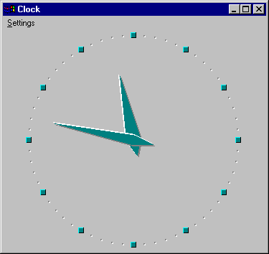
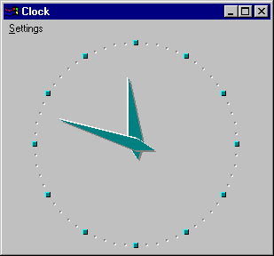
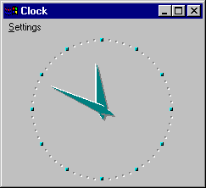
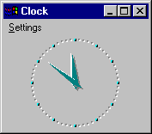

The Incredible Shrinking Clock
Invoke, maximize, close, invoke, minimize, close, invoke, restore,close, …

Slide 64
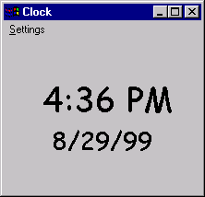
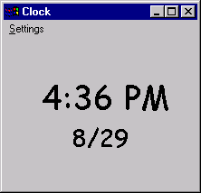
That Was The Year That Wasn’t
Start
Minimize
Stop
Start
Restore
Date
bug

Slide 65
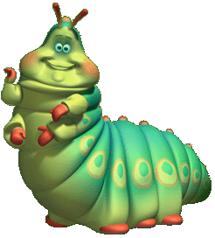
An 84-step repro sequence
invoke about ok_about no_title doubleclick seconds restore seconds doubleclick doubleclick date about ok_about restore gmt maximize doubleclick doubleclick date seconds date close_clock invoke close_clock invoke close_clock invoke seconds date restore about ok_about no_title doubleclick digital doubleclick doubleclick no_title doubleclick no_title doubleclick seconds restore restore doubleclick doubleclick gmt analog maximize date digital minimize restore minimize close_clock invoke restore digital date minimize close_clock invoke maximize gmt digital restore doubleclick doubleclick about ok_about maximize digital digital digital seconds analog about ok_about about ok_about minimize close_clock invoke restore date

Slide 66
Reducing the Sequence:
Initial path length: 84 steps
Shortcut attempt 2 : repro sequence: 83 steps
Shortcut attempt 3 : repro sequence: 64 steps
Shortcut attempt 4 : repro sequence: 37 steps
Shortcut attempt 5 : repro sequence: 11 steps
Shortcut attempt 7 : repro sequence: 9 steps
Shortcut attempt 20 : repro sequence: 8 steps
Shortcut attempt 29 : repro sequence: 6 steps

Slide 67
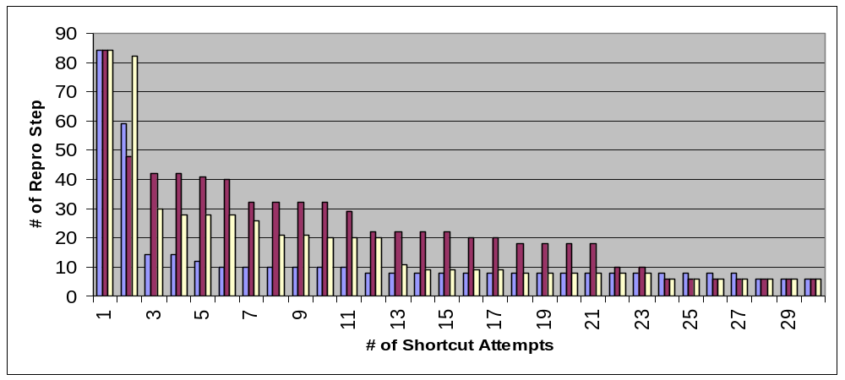
# Repro Steps Over Time

Slide 68
Gawain
Graph Algorithm Without An Interesting Name

Slide 69
The Motivation
Our experience [with random testing] has been that … the paths generated are sometimes nonsensical in that the transitions appearing in a specific sequence have little to do with making the software do real work. Imagine a model for a word processor that doesn’t generate a sequence in which the document is typed, formatted, spell checked and then printed. …
J. A. Whittaker
M. Al-Ghafees
type
format
spell check
print

Slide 70
The Gawain Approach
assign the same weight to each arc in a graph
choose a path through the graph
assign a low weight to each arc in that path
exercise paths in graph in weight-increasing order

Slide 71
Assign the same weight to each arc
5
5
5
5
5
5
5
5
5

Slide 72
Choose a path through the graph
5
5
5
5
5
5
5
5
5

Slide 73
Assign a lower weight to each arc in that path
5
1
1
1
1
5
5
5
5
Weight of this path = 4

Slide 74
Execute all paths with total weight less than some amount “X”
5
1
1
1
1
5
5
5
5
E.g., weight of this path = 8

Slide 75
5
1
1
1
1
5
5
5
5
Weight of this path = 8

Slide 76
5
1
1
1
1
5
5
5
5
Weight of this path = 8

Slide 77
5
1
1
1
1
5
5
5
5
Weight of this path = 9

Slide 78
5
1
1
1
1
5
5
5
5
Weight of this path = 11

Slide 79
5
1
1
1
1
5
5
5
5
You end up “Cocooning” the regression path

Slide 80
Model-Based Testing
Programmatic
Efficient coverage
Tests what you expect and what you don’t
Finds crashing and non-crashing bugs
Significant investment in tested app
Resistant to pesticide paradox
Fun to watch

Slide 81
Monkey Models
Nothing I do
should make this app crash…
1.2
a P, a P, ab P, ab P 2, abc P, P, P, P,
\\scbuild1
Type 5
containing message laurie Bill's October
? A
? v?-0Qrg+ 'cQ?_<$ ` Z`i7c} oV? E1X …
nov 31, 2000 Oct, 2000 dates Wednesday …
alike. In Word documents, for example …
3 M note
RNL in Office 10

Slide 82

Production Grammar Models
Find all mail from James
Fetch any messages sent by james
Mail from jim
Show me mail by Jimmy
Display messages received from Jim
As far as I know,
all these mean
the same thing.

Slide 83
Production Grammar Models
Inbox Query 1 = <verb phrase><determinative> inbox phrase><author phrase>
Verb phrase = show | show me | find | find me | display | fetch | <nothing>
Determinative = any | all | the | all the | <nothing>
Inbox phrase = mail | email | messages
Author phrase = by <person> | from <person> | sent by <person> | by <person>
Person = James | james | Jim | jim | Jimmy | jimmy
Nothing = [this line intentionally left blank]

Slide 84


Set Theory Models
Hmm …
if I know I have 3 emails from James
and I ask for “email from James”
then I should get back 3 emails.
Email from James

Slide 85
Set Theory Models
(with generated data)
query
data
creator
Our
database
Compare
results

Slide 86
Why Does Model-Based Testing Work?
system under test
complexity
model
speed
“… I think that less than 10 percent of most programs’ code is specific
to the application. Furthermore, that 10 percent is often the easiest 10 percent.
Therefore, it is not unreasonable to build a model program to use as an oracle.”
–Boris Beizer, Black Box Testing, p.63

Slide 87
Benefits of Model-Based Testing
Easy test case maintenance
Reduced costs
More test cases
Early bug detection
Increased bug count
Time savings
Time to address bigger test issues
Improved tester job satisfaction

Slide 88
Obstacles to Model-Based Testing
Comfort factor
  This is not your parents’ test automation
Skill sets
  Need testers who can design
Expectations
  Models can be a significant upfront investment
  Will never catch all the bugs
Metrics
  Bad metrics: bug counts, number of test cases
  Better metrics: spec coverage, code coverage

Slide 89
Resources
Model-based testing website:
www.model-based-testing.org
Books:
  “Black-Box Testing : Techniques for Functional Testing of Software and Systems” by Boris Beizer
  “Testing Object-Oriented Systems: Models, Patterns, and Tools” by Robert Binder
  “Software Testing: A Craftsman's Approach” by Paul Jorgensen

Slide 90
Q & A

